Slide 1
CIS 4517/5517: Data Intensive and Cloud Computing Cloud Computing service models and Amazon Cloud
Dr. Xubin He
Computer and Information Sciences
Temple University

Slide 2
Outline
Cloud computing service models
Amazon Cloud: AWS
AWS overview
Application examples
Using Amazon EC2 instances
Courtesy: Some slides are adopted and modified from C. Borcea.

Slide 3

Review from last class
Parallel and distributed systems:
The fraction of the sequential part of a program limits the maximum performance speedup: Amdahl’s Law
Long latency to remote memory: even a very small percentage of instructions involving remote memory access will have a big impact on the overall performance.
Tradeoff: Program needs sufficiently large units of work to run fast in parallel (i.e., large granularity), but not so large that there is not enough parallel work.

Slide 4
Load balancing
Load imbalance leads to some idle processors in the system
Insufficient parallelism (during that phase)
Unequal size tasks
Program needs to balance load
Sometimes can determine workload, divide up evenly, before starting: static load balancing
Sometimes workload changes dynamically, need to rebalance dynamically: dynamic load balancing

Slide 5
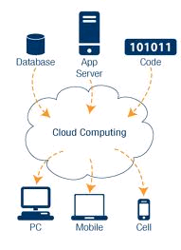
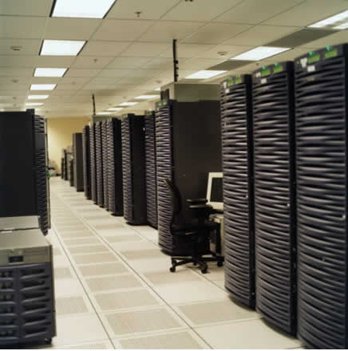
Cloud computing at a glance
Utility computing: our data and applications are hosted somewhere on the Internet (“in the cloud”)
Most services we access over the Internet are in the cloud (e.g., Google, Amazon, Yahoo)
Benefits:
Providers: economies of scale by having many users sharing the same infrastructure
Consumers: reduced cost and overhead
Cloud infrastructure =
Data centers with
100,000’s servers
What is a datacenter?

Slide 6
Cloud requirements (Yahoo!)
Multi‐tenancy: Many apps co‐existing on the same infrastructure
Elasticity: Fast and graceful response to changing resource requirements
Scalability: Scaling to growing data and apps
Load and tenant balancing: absorbing load spikes, not to overload the hardware
Availability: the cloud must be (almost) always on
Security: No security breach into the cloud
Metering: Monitoring cloud usage for resource provisioning and billing
Simple APIs: Simplify deploying and tuning applications in the cloud

Slide 7
Technical view
Computing resources
Clusters of computers (massive parallelism)
Virtualization (sharing of resources)
Large scale storage facilities (access to data)
Network
Web services

Slide 8
Cloud entities
Cloud providers provide various services to cloud customers.
Cloud providers: offer hardware & management tools
provide system services (e.g., local OS + persistent storage + system software like compilers)
Can provide other (user-level) services (such as email)
Cloud customers
Users: use the services offered by service providers

Slide 9
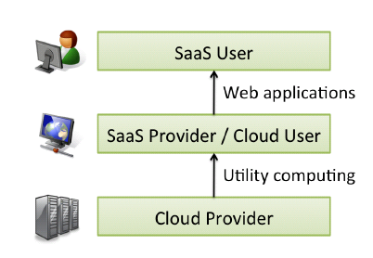
Types of services (X as a Service)
Infrastructure-as-a-Service (IaaS)
Virtual servers with unique IP addresses and blocks of storage on demand (e.g., Amazon EC2, Google Compute Engine)
Platform-as-a-Service (PaaS)
Set of software and development tools (API) hosted on the provider's servers (e.g., Windows Azure, Google AppEngine)
Software-as-a-Service (SaaS)
The provider allows the customer only to use its applications (e.g., web-based email, web stores, etc)

Slide 10
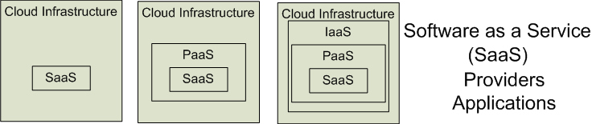
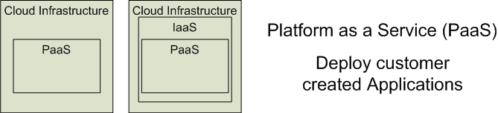

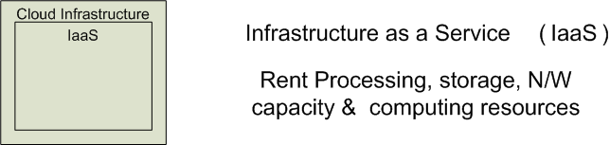


Cloud Service Models
Software as a Service (SaaS)
Platform as a Service (PaaS)
Infrastructure as a Service (IaaS)
SalesForce CRM
LotusLive
Adopted from: Effectively and Securely Using the Cloud Computing Paradigm by peter Mell, Tim Grance
AEffectively and Securely Using the Cloud Computing Paradigm by peter Mell, Tim Grance
Notes:
IaaS delivers computer infrastructure, typically a platform virtualization environment, as a service. Rather than purchasing servers, software, data center space or network equipment, clients instead buy those resources as a fully outsourced service.
PaaS delivers a computing platform where the developers can develop their own applications.
SaaS is a model of software deployment where the software applications are provided to the customers as a service.

Slide 11
Virtualization
Virtual workspaces:
An abstraction of an execution environment that can be made dynamically available to authorized clients by using well-defined protocols,
Resource quota (e.g. CPU, memory share),
Software configuration (e.g. O/S, provided services).
Implement on Virtual Machines (VMs):
Abstraction of a physical host machine,
Hypervisor intercepts and emulates instructions from VMs, and allows management of VMs,
VMWare, Xen, KVM, etc.
Provide infrastructure API:
Plug-ins to hardware/support structures
App
App
App
OS
OS
OS
Hypervisor
Hardware
Virtualized Stack

Slide 12
New application opportunities with cloud
Parallel batch processing
Get fast answers when processing large amounts of data
“Using hundreds of computers for a short time costs the same as using a few computers for a long time”
Mobile applications & services
Store large data sets & perform complex computations in the cloud (e.g., scientific analysis, augmented reality)
Could maintain a virtual copy of your device in the cloud & potentially offload computations there
Extensions of desktop software
Matlab, Mathematica, MS office

Slide 13
Business view
Shift in economic model: the relevance and weight of technology diminishes as it becomes commodity and standardized (electricity grid, phone, water supply)
Providers: economies of scale by having many users sharing the same infrastructure
Main reason why cloud computing happened when very large data centers have started to appear
Consumers: reduced cost and overhead

Slide 14
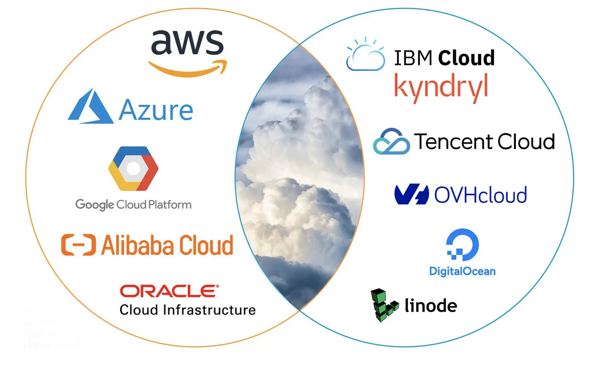
Top cloud players
Source: https://dgtlinfra.com/top-10-cloud-service-providers-2022/

Slide 15
Provider’s benefits
Renting an IT infrastructure to many users
Sharing of resources
Reduction of costs through scale
Centralized monitoring and maintenance
Control over software evolution
Control over service level agreements

Slide 16
Consumer’s benefits
Reduced capital expenditure for hardware, software, services
Reduced operational expenses - Pay as you go (dynamic provisioning)
Simple to achieve scalability and flexibility
More predictable costs
Complete a task in 1 hour using 100 machines vs 100 hours using 1 machine.

Slide 17




Traditional data center: heavy penalty for under-provisioning
Resources
Capacity
Demand
Resources
Capacity
1
2
3
Time (days)
Demand
Lost revenue
1
2
3
Time (days)
Resources
Capacity
Demand
1
2
3
Time (days)
Lost users

Slide 18
Overprovisioning?
Capacity
Resources
Demand
Time
Static data center
Unused resources

Slide 19
Economics of cloud model
Resources
Capacity
Demand
Time
Data center in the cloud

Slide 20
Drawbacks of the cloud
Too much control on the provider side
Privacy and security
Legislation related to data management
Data movement cost

Slide 21
IDC cloud report
Cloud Going Mainstream: All Are Trying, Some Are Benefiting; Few Are Maximizing Value, by R. Mahowald et al, September 2016.

Slide 22
Academic clouds
Emulab: https://www.emulab.net/
PlanetLab: http://www.planet-lab.org/ (officially shutting down in May 2020).
Chameleon Cloud: https://www.chameleoncloud.org/
CloudLab: https://www.cloudlab.us/, build your own cloud on their hardware

Slide 23

Academic Cloud: Emulab https://www.emulab.net/
A community resource open to researchers in academia and industry.
Widely used by researchers everywhere today.
Founded and owned by University of Utah (led by Late Prof. Jay Lepreau)
As a user, you can:
Grab a set of machines for your experiment
You get root-level (sudo) access to these machines
You can specify a network topology for your cluster
You can emulate any topology
Slide source by IG: https://courses.engr.illinois.edu/cs425/fa2019/L2-3.FA19.ppt

Slide 24
Cloud platform example: AWS
AWS Overview
Application example
Using Amazon EC2 instances

Slide 25
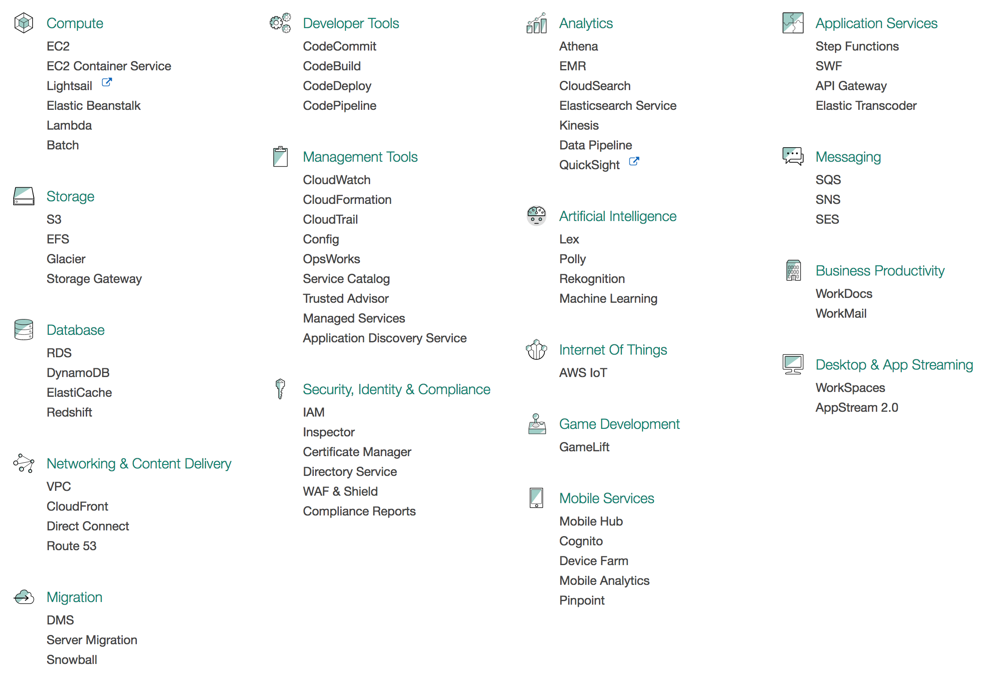
AWS Services

Slide 26
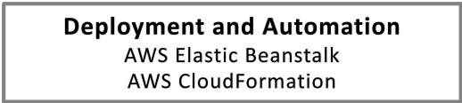
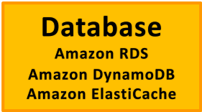
The AWS Cloud For Enterprises
Your Application
Libraries and SDKs
.NET/Java etc.
Web Interface
Management Console
Tools
AWS Toolkit Eclipse, VS
Command Line Interface
Tools to access services
Auth, Authorization, Federation AWS IAM, MFA
Monitoring
Amazon CloudWatch
Cross Service features
Parallel Processing
Amazon Elastic MapReduce
Transfer
Import Export
VM Import
Storage Gateway
Content Delivery
Amazon CloudFront
Messaging
Amazon SNS
Amazon SQS
Amazon SES
Search
Amazon CloudSearch
High-level building blocks
Compute
Amazon EC2
Auto Scaling
Storage
Amazon S3
Amazon EBS
Network
Amazon VPC
ELB, DirectConnect
Amazon Route 53
Low-level building blocks
Note: This slide is adopted from J. Varia@Amazon

Slide 27
AWS service: Compute and monitoring
Compute
Elastic Compute Cloud (EC2): launch on-demand virtual machines (instances)
Elastic MapReduce: automatically starts Hadoop implementation of MapReduce for parallel applications
Amazon handles cluster management
Auto Scaling: seamlessly increase/decrease number of EC2 instances function of load
Done based on metrics reported by CloudWatch
Monitoring
CloudWatch: monitor cloud resources such as CPU cycles, disk access, network traffic

Slide 28
AWS Service: Storage
Simple Storage Service (S3): provide persistent object storage
Independent of EC2 instances
EC2 instances need to “download” data from S3 in order to access it (cannot issue read/write to S3)
Amazon Glacier: low-cost storage service that provides secure and durable storage for data archiving and backup
Advantage over S3: offload the administrative burdens of operating and scaling storage + cost
Disadvantage: slower than S3
Elastic Block Store (EBS): provide block level storage volumes (virtual disk, i.e., disk-like) to EC2 instances
Persistent even after instances are terminated
Instances have to mount EBSs (EFS)

Slide 29
AWS service: Database
DynamoDB: non-relational database service, fully-managed, high performance, easy to set up, operate, and scale
Relational Database Service (RDS): full-featured MySQL database
Amazon ElastiCache: a web service that makes it easy to deploy, operate, and scale an in-memory cache in the cloud
Load data in memory and access it there instead of going to disk
http://memcached.org

Slide 30
AWS service: Messaging
Simple Queue Service (SQS): reliable & scalable mechanism for asynchronous communication
Asynchronous communication simplifies fault-tolerance
Can be used for communication between EC2 instances or between machines outside the cloud and EC2 instances
Simple Notification System (SNS): event-driven system that sends “push” notifications (from the cloud) to multiple applications
Publish-subscribe mechanism
Simple Email Service (SES): yet another email system

Slide 31
AWS Service: Networking
Networking
Route 53: DNS service that provides automatic availability & scalability
Virtual Private Cloud: allows integration of company machines with EC2 instances in one network (using IPSec VPN)
Elastic Load Balancing: automatically distributes incoming traffic to multiple EC2 instances
AWS Direct Connect: establish a dedicated connection from your premise to AWS (1GB/10GB fiber)
Web
CloudFront: CDN (content distribution network) service
Like all CDNs uses caches at the edge of the network
Works for both static content and streaming
Alexa Web Information Service (AWIS): provides web analytics

Slide 32
EC2 instances
Instances: Virtual machines that run in the EC2 environment
Each instance is like a “physical” machine that has its own CPU, memory, network interface, and disk space (volatile – data is lost when the instance is terminated)
Xen used for virtualization
AMI (Amazon Machine Image): Encrypted file that captures a complete snapshot of an EC2 instance at a point in time, including its software, configuration, and data
Images are stored in S3 and serve as boot disks for instances
Linux/Solaris and Windows images publicly available
Users can create AMI from scratch: start from any public AMI, install & customize the software needed, and then store it as private AMI to use later on

Slide 33
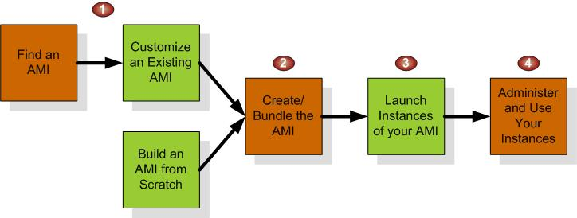
EC2 environment
Provides instance management and configuration services
Launch and terminate instances
Control the instance properties (e.g., type of instance, AMI) through a simple web interface
Set network access permissions for instances
Instance creation:

Slide 34
Auto Scaling
Auto Scaling helps maintain application availability and allows users to scale an Amazon EC2 capacity up or down automatically according to defined conditions.
To ensure that you are running your desired number of Amazon EC2 instances.
Auto Scaling can also automatically increase the number of Amazon EC2 instances during demand spikes to maintain performance and decrease capacity during low demands to reduce costs.

Slide 35
Simple Storage Service (S3)
Concepts
Objects and keys: an object (with an associated key) is stored in S3
Buckets: where the data is stored (“unlimited storage”)
A bucket is a container for objects and describes location, logging, accounting, and access control. A bucket can hold any number of objects, which are files of up to 5TB. A bucket has a name that must be globally unique.
Fundamental operations corresponding to HTTP actions:
http://bucket.s3.amazonaws.com/object
POST a new object or update an existing object.
GET an existing object from a bucket.
DELETE an object from the bucket
LIST keys present in a bucket, with a filter.
A bucket has a flat directory structure (despite the appearance given by the interactive web interface.)

Slide 36
Simple Storage Service (S3)
Resources are identified by URIs
Example: http://cis4517.s3-us-west-2.amazonaws.com/CloudChronicles.pdf
cis4517 is the bucket
CloudChronicles.pdf is the object
Has an access control mechanism to allow/deny access
Limitations
Not possible to modify a small portion of a file
Need to rewrite the whole object again with the modification
Changes take time to propagate

Slide 37
Elastic Block Storage (EBS)
EBS are raw unformatted persistent virtual disks for EC2 instances
Size: up to 20 TB (1TB=2⁴⁰ bytes)
Each user can use up to 5000 EBS volumes
An EBS can be attached to only one instance at a time
EBS can be used as boot partition for instances: fast startup time
An instance can mount multiple EBSs
Volumes are replicated for availability
Snapshot feature
Users can create incremental snapshots to S3
Good for sharing & instantiating new volumes
Extra availability

Slide 38
Elastic Block Store
An EBS volume is a virtual disk of a fixed size with a block read/write interface. It can be mounted as a filesystem on a running EC2 instance where it can be updated incrementally. Unlike an instance store, an EBS volume is persistent.
(Compared to an S3 object, which is essentially a file that must be accessed in its entirety.)
Fundamental operations:
CREATE a new volume (1GB-1TB)
COPY a volume from an existing EBS volume or S3 object.
MOUNT on one instance at a time.
SNAPSHOT current state to an S3 object.

Slide 39
Outline
Cloud computing service models
Amazon Cloud: AWS
AWS overview
Application examples
Using Amazon EC2 instances

Slide 40
Online photo processing service (1)
Users submit Photos and specify operations they want over their photos:
Red eye detection, Cropping, Re-coloring, etc
Requests are put on Request Queue and photos are saved in S3 storage area
Photo Processing Server gets the request, retrieves photos from S3 storage, performs processing, and sends result using Response Queue

Slide 41
Online photo processing service (2)
If more than one instance is needed, user can initiate more instances
Message queue can be used by multiple instances
Message retrieved by one instance is locked, such that other instances cannot see it

Slide 42
Online photo processing service (3)
Pipeline processing: if an operation takes more time, user can create another instance to handle the time consuming jobs
Suppose server B performs the time consuming jobs
Server A and B can communicate using SQS

Slide 43
Case study
The New York Times used AWS to create PDF files of its whole archive
100 Amazon EC2 instances running Hadoop application
Processed 4TB of raw TIFF image data (stored in S3) into 11 million finished PDFs
Running time: 24 hours
Cost: $240 (not including bandwidth)
New York Times report

Slide 44
Outline
Cloud computing service models
Amazon Cloud: AWS
AWS overview
Application examples
Using Amazon EC2 instances

Slide 45
Getting Started with Amazon EC2
Step 1: Sign up for Amazon EC2
Step 2: Create a key pair
Step 3: Launch an Amazon EC2 instance
Step 4: Connect to the instance
Step 5: Customize the instance
Step 6: Terminate instance and delete the volume created

Slide 46
Terminology
Instance: One running virtual machine.
Instance Type: hardware configuration: cores, memory, disk etc.
Amazon Machine Image (AMI): Description of an instance. It provides the information required to launch an instance.
Key Pair: Credentials used to access VM from command line.
Region: Geographic location, price, laws, network locality.
Availability Zone: Subdivision of region that is fault-independent.
EBS: Elastic Block Store: provides persistent block level storage volumes for use with Amazon EC2 instances in the AWS Cloud.

Slide 47
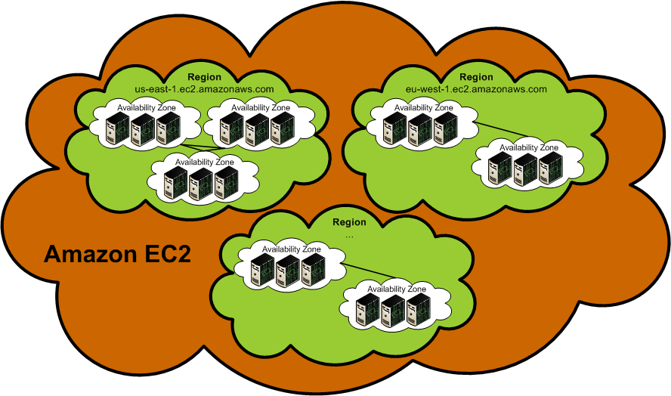
Regions and availability zones
Regions are located in separate geographic areas (US: Virginia & California, Ireland, Singapore, etc.)
Each Region is completely isolated
Failure independence and stability
Availability Zones are distinct locations within a Region
Isolated, but connected through low-latency links
Failure resilience

Slide 48
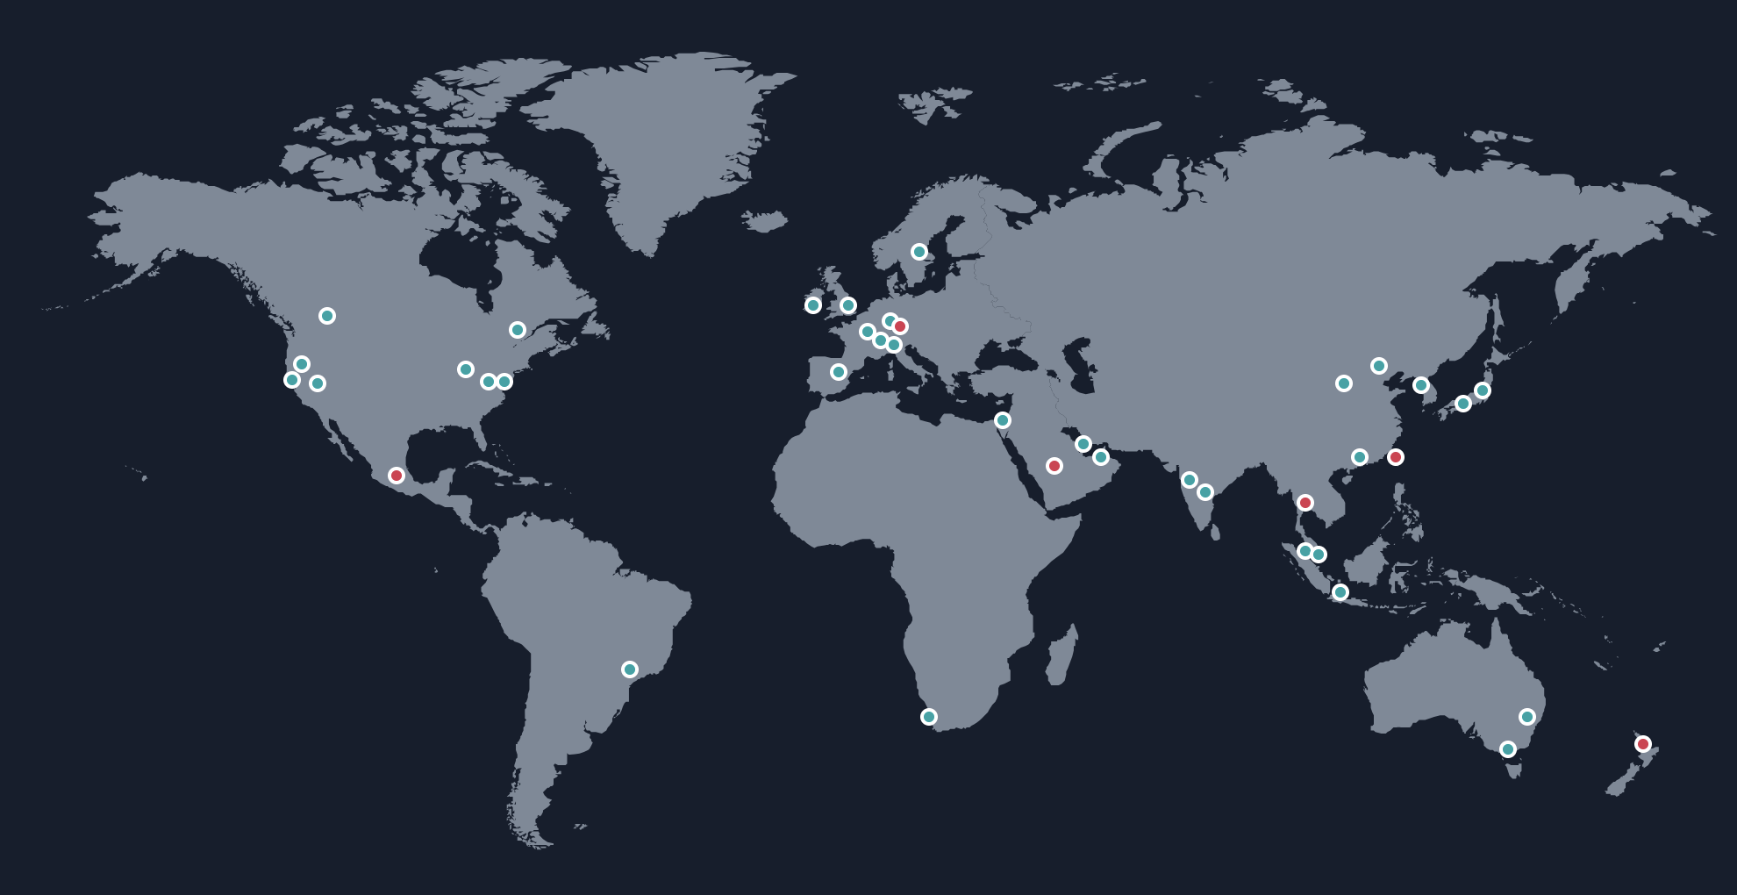
AWS Global Infrastructure
The AWS Cloud spans 108 Availability Zones within 34geographic regions around the world, with announced plans for 18 more Availability Zones and 6 more AWS Regions (as of August 30, 2024).
Source: https://aws.amazon.com/about-aws/global-infrastructure/

Slide 49
Instance types
Some typical instance types:
General purpose: mac, T2, T3, M3, M4, M5x, M6x, M7x…
Compute optimized: C7x, C6g, C4…
Memory optimized: R7x, R6x, R5x, X1, R4, R3
Accelerated computing instances (eg. GPUs): P5, P4, P3, P2, G2…
Storage optimized: I4x, I3, I2, D2
HPC optimized: hpc7x, hpc6x
https://aws.amazon.com/ec2/instance-types/

Slide 50
EC2 Pricing Model
Free Usage Tier: Free EC2 instances, including 750 hours of Linux and Windows t2.micro instances (t3.micro for the regions in which t2.micro is unavailable), each month for one year.
On-Demand Instances
Start and stop instances whenever you like, costs are rounded up to the nearest hour. No contract. (Worst price)
Reserved Instances
Pay up front for one/three years in advance. (Lower price)
Spot Instances
Specify the price you are willing to pay, and instances get started and stopped without any warning as the marked changes. (Bid)
Dedicated Hosts
A Dedicated Host is a physical EC2 server dedicated for your use.
Current pricing: http://aws.amazon.com/ec2/pricing/

Slide 51
Launch an EC2 instance
A video is available for you to access in course canvas (under Resources tab).
Once you are done, remember to stop your instance (but don’t terminate it). If you stop your instance, later you can re-start it. However, if you terminate your instance, your EC2 is gone and all your work on this EC2 is lost.
AWS tutorial for beginners (~11 min)

Slide 52
Next
More Cloud platform practices:
Google Cloud
Microsoft Azure
Cloud application development
Create your own AWS account if you haven’t done so and play with it. It’s free!
Homework: Launching & Configuring an EC2 Instance (details please refer to the course Canvas).
Quiz 1

